Slide 1


How to Improve Emotional Intelligence

Slide 2
Key Points
01
Identification of emotional state
02
Tips and techniques to regulate own and others emotions
03

Slide 3
Emotional intelligence is the ability to be aware of, and effectively use, our own feelings and emotions of those around us.

Slide 4
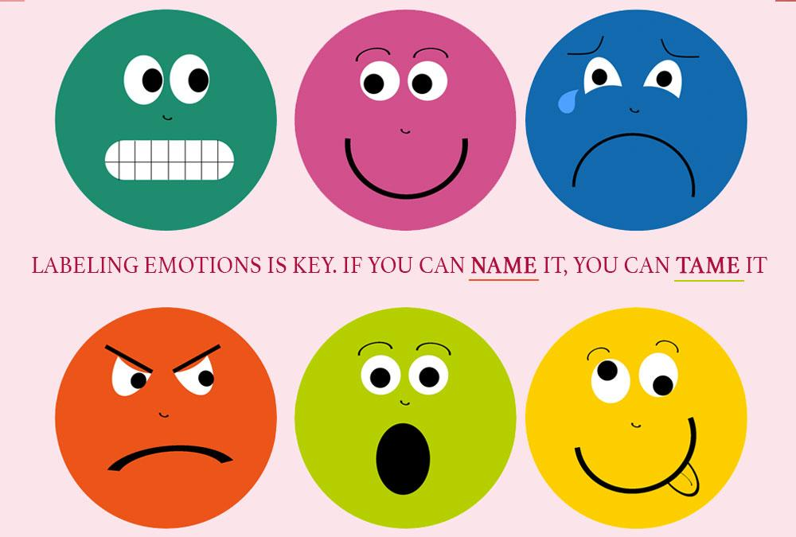

Slide 5
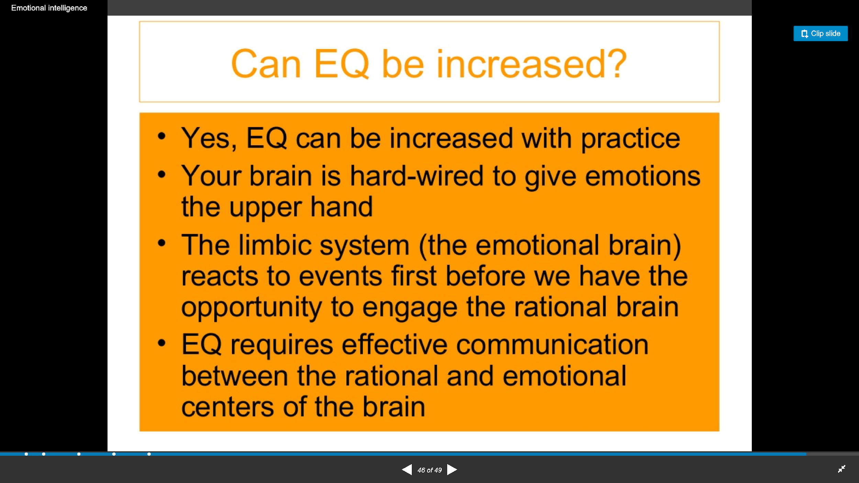

Slide 6
The Five Essentials of EI
According to Daniel Goleman these essential skills greatly enhance, or hurt, our quality of life.
Self awareness: Knowing what you are feeling when you feel it.
Managing your emotions: Knowing what to do with your feelings.
Motivating yourself: Channeling your feelings in the right direction without
acting impulsively.
Empathy: Feeling for others and accepting their feelings, too.
Handling relationships: Having good interpersonal skills so others feel good
about you.

Slide 7
Identifying Emotions (Branch 1)
Skills needed to perceive and express feelings.
Recognizing facial expressions.
Non-verbal communication.
Tell when someone is being real.
Express accurate emotions for situation.

Slide 8
Facilitating Emotions (Branch 2)
Using emotions to facilitate thinking.
Improve problem solving and boost creativity.
Emotional component to motivation.
“Care enough to send the very best.”
Using emotion to help make decisions.

Slide 9
Facilitation (MSCEIT)
What mood(s) might be helpful to feel when meeting in-laws for the very first time?
Not Useful Useful a) Tension 1 2 3 4 5
b) Surprise 1 2 3 4 5
c) Joy 1 2 3 4 5
Generate an emotion and solve problems with that emotion.
Creating the right feeling to assist in problem solving, communicating a vision, leading people.

Slide 10
Understanding emotions (Branch 3)
Understanding complex and conflicting emotions.
Emotions and behavioral consequences.
Read a situation and respond correctly.
Some emotional responses are maladaptive.
Jealousy and envy are destructive.

Slide 11
Understanding Emotions (MSCEIT)
Tom felt anxious, and became a bit stressed when he thought about all the work he needed to do. When his supervisor brought him an additional
project, he felt ____. (Select the best choice.)
a) Overwhelmed-snowed under
b) Depressed
c) Ashamed
d) Self Conscious
e) Jittery-Nervous
Being able to predict how people will emotionally react.

Slide 12
Managing emotions (Branch 4)
Developing mood regulation skills.
Productive ways to change mood.
Avoid over and under regulation.
Seek natural means rather than alcohol, tobacco or other drugs.
Stress coping strategies.

Slide 13
Managing Emotions (Branch 4)
Sara just came back from vacation. She was feeling peaceful and content. How well would each action preserve her mood?
Action 1: She started to make a list of things at home that she needed to do.
Very Ineffective..1.....2.....3.....4.....5..Very Effective
Action 2: She began thinking about where and when she would go on her next vacation.
Very Ineffective..1.....2.....3.....4.....5..Very Effective
Action 3: She decided it was best to ignore the feeling since it wouldn't last anyway.
Very Ineffective..1.....2.....3.....4.....5..Very Effective
Stay open to emotions and blend with thinking.
Integrate emotion and thought to make effective decisions.

Slide 14
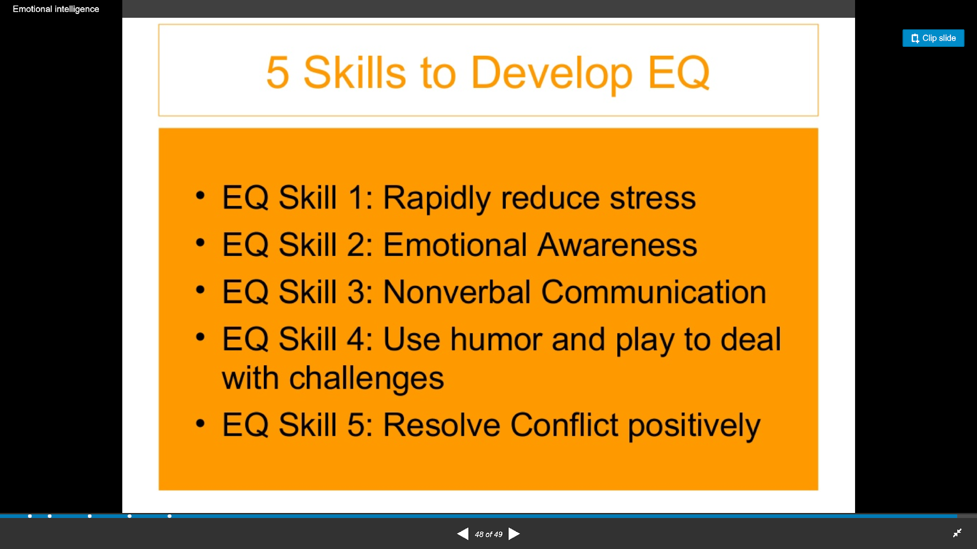

Slide 15
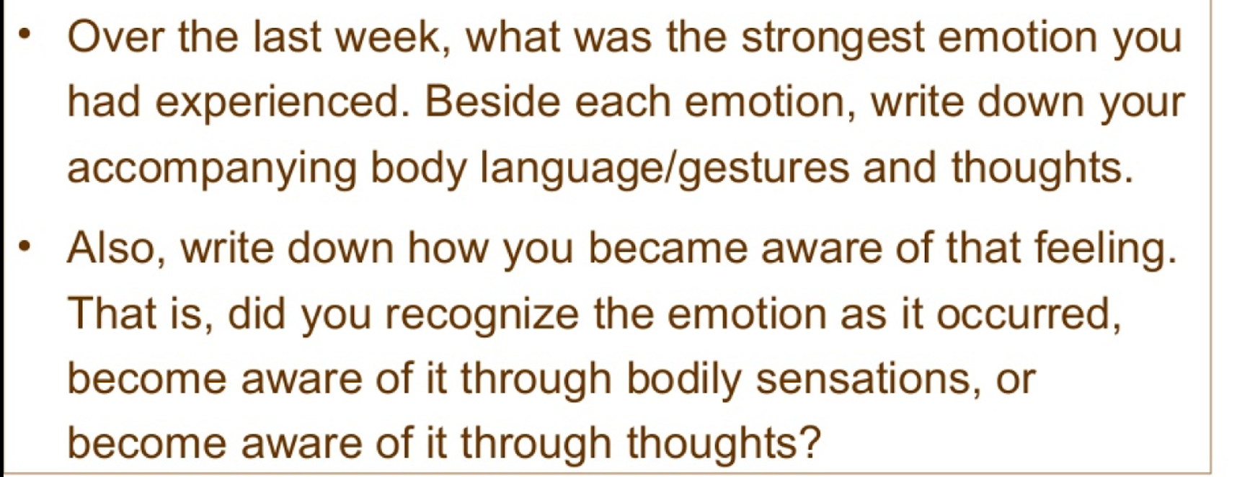
Task # Emotional Awareness

Slide 16
Thank you

